Slide 1
Group members in 1999
Hanna Yuan’s lab

Slide 2
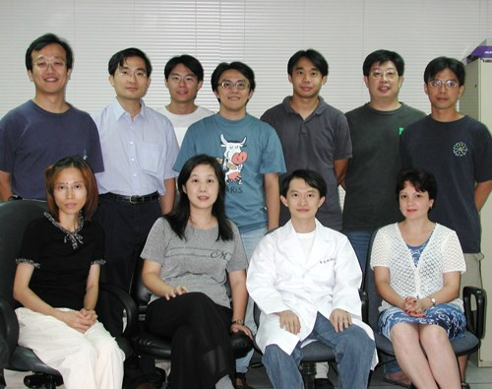
Group members in 2001
Hanna Yuan’s lab

Slide 3
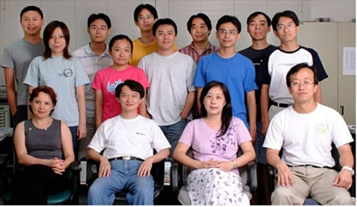
Group members in 2003
Hanna Yuan’s lab

Slide 4
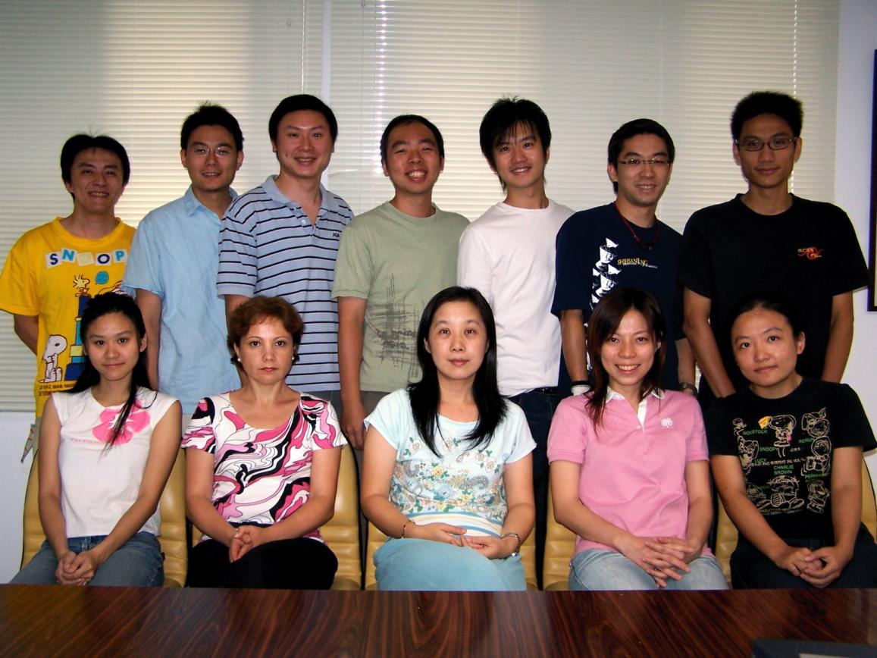
Group members in 2005
Hanna Yuan’s lab

Slide 5
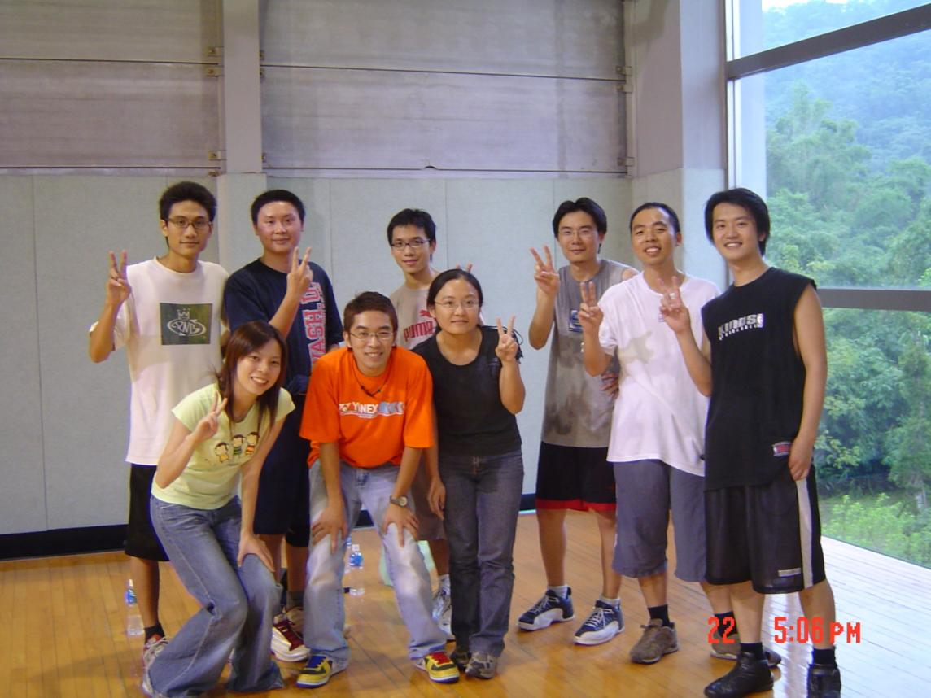
Basketball game in 2005

Slide 6
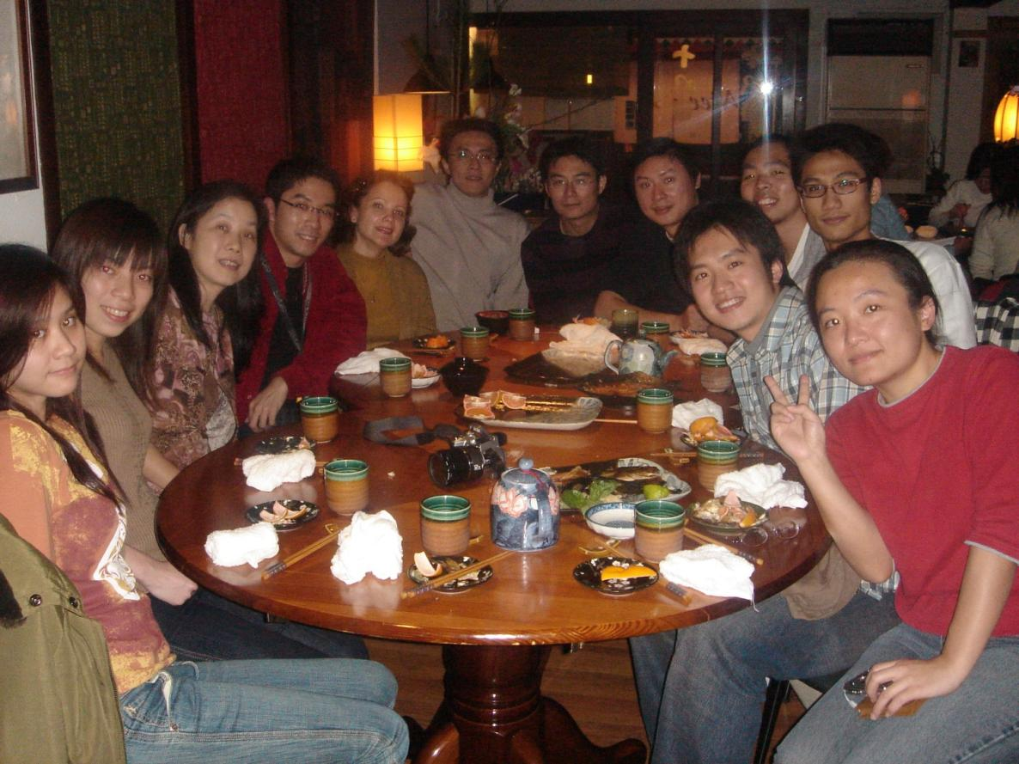
Group dinner in 2006

Slide 7
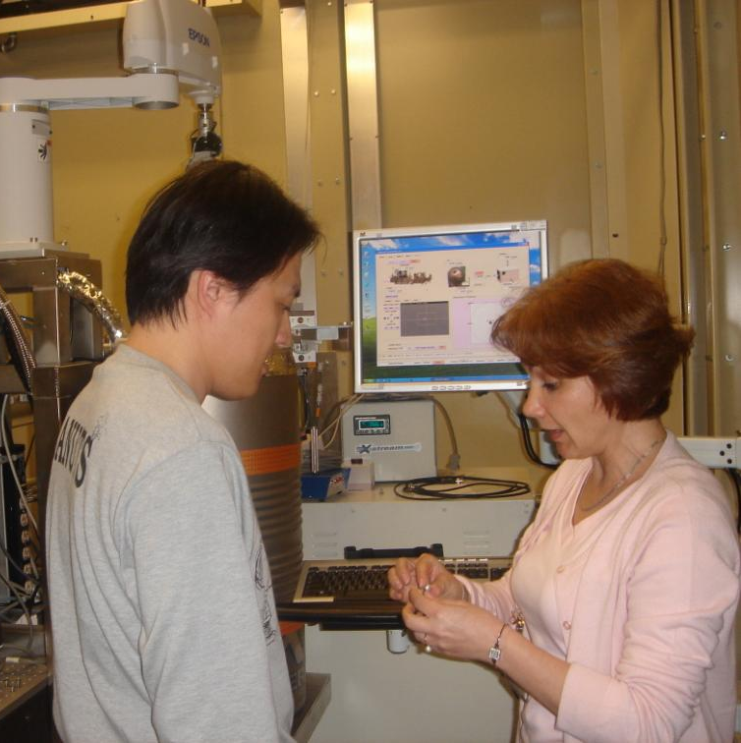
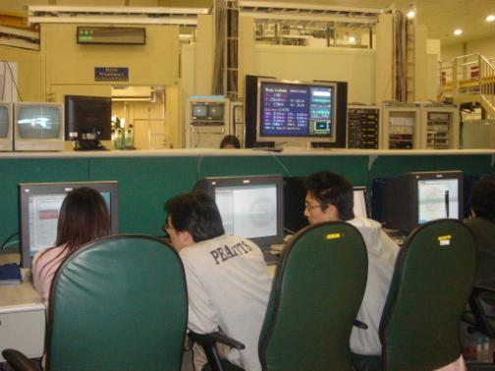
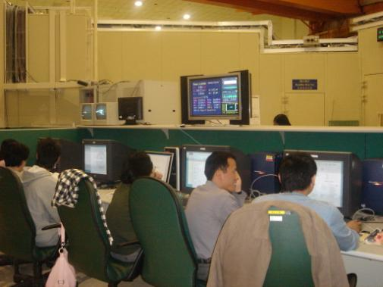
Data collection in NSRRC in 2006
同步輻射中心做實驗

Slide 8
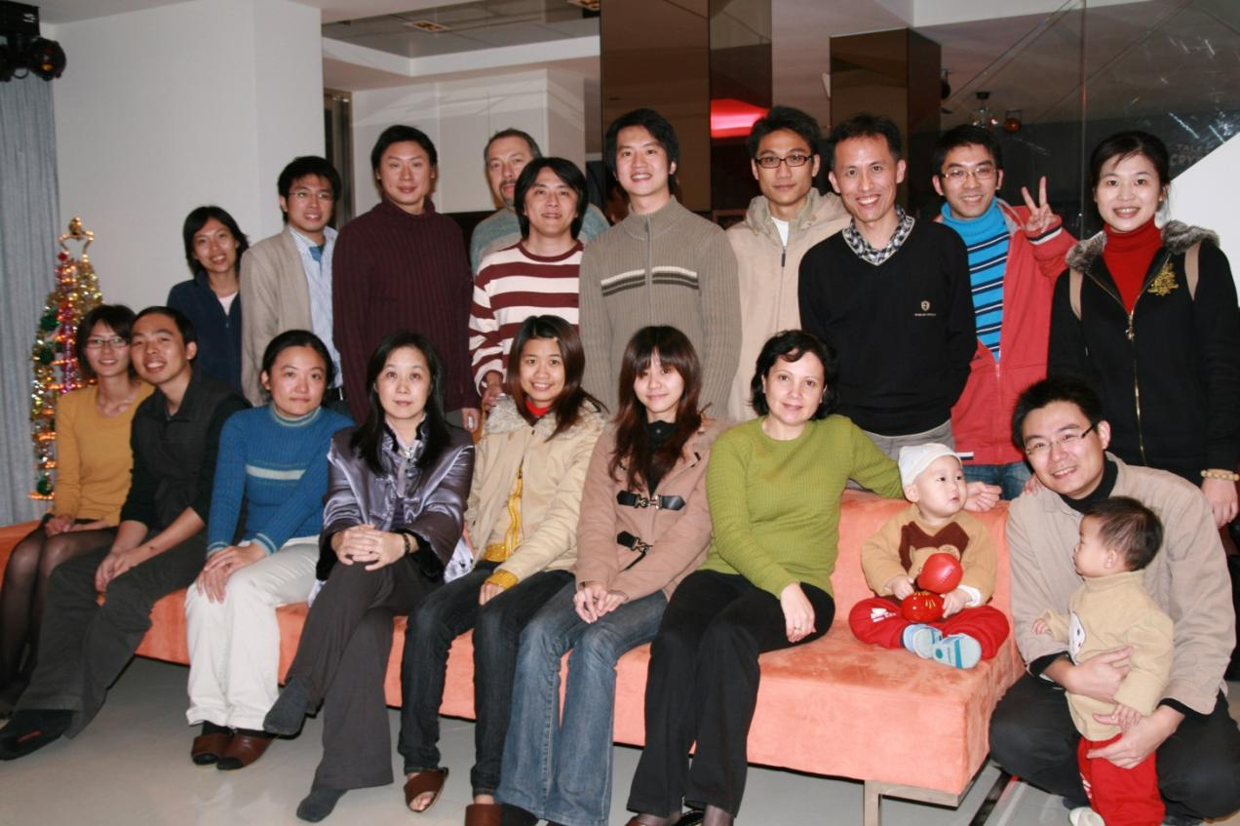
Group dinner in 2008

Slide 9
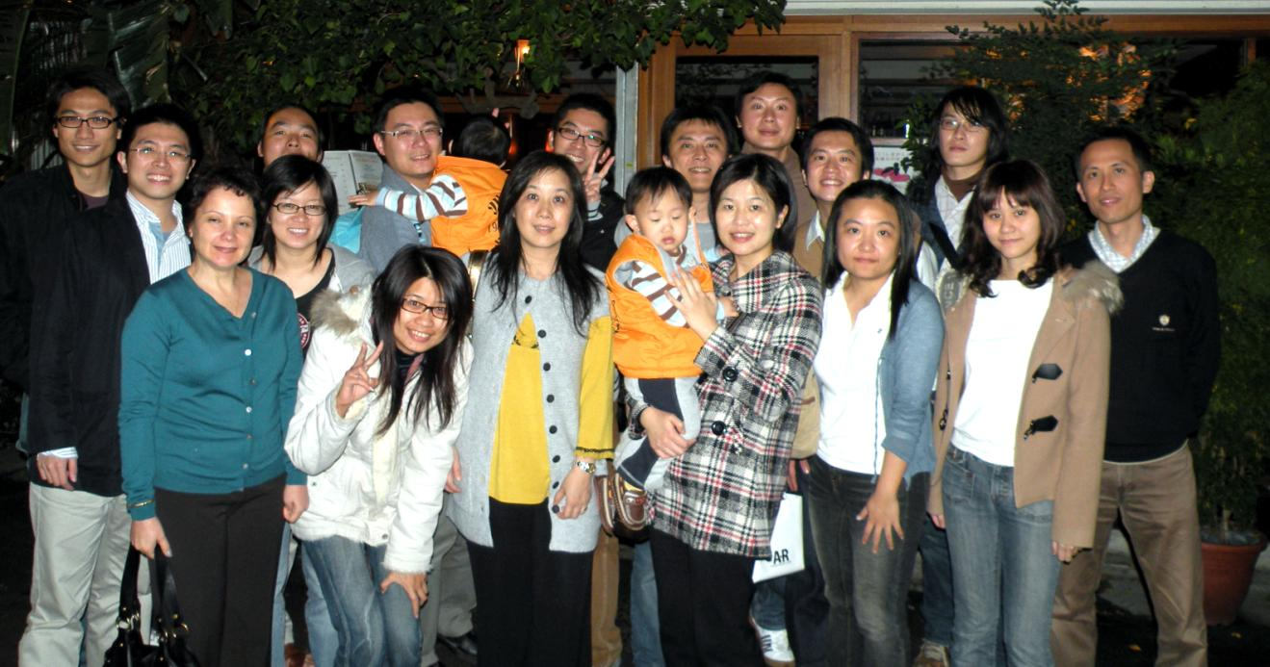
Farewell dinner for Chia-Lung Li 李家隆 in 2009

Slide 10
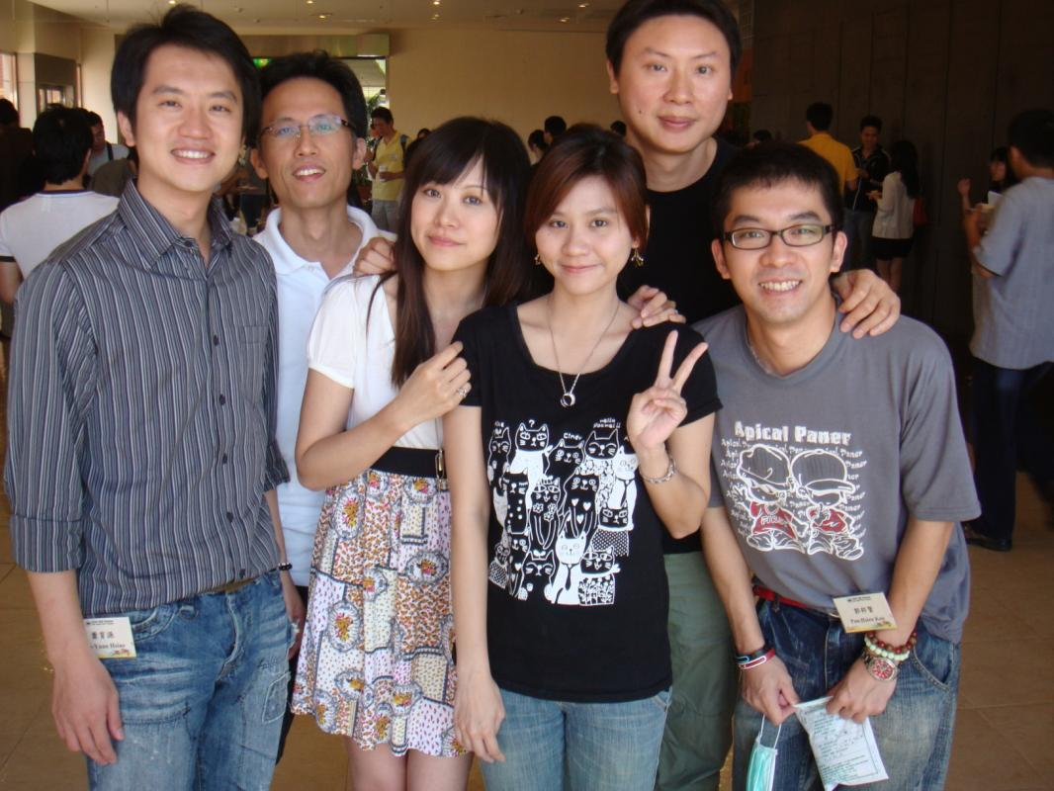
Biophysics Annual Meeting in 2009
生物物理年會於成功大學

Slide 11
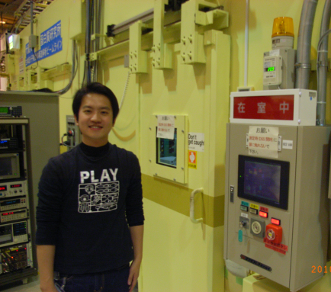
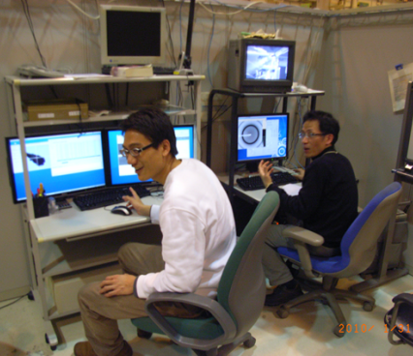
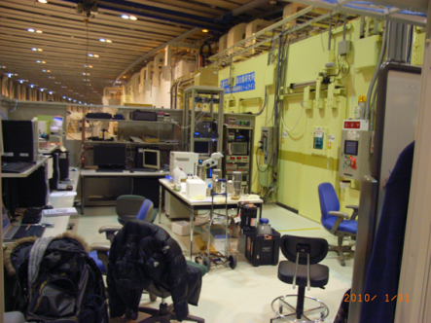
Data collection in Spring-8 (XU44 Beamline) in 2010
日本同步輻射中心做實驗

Slide 12
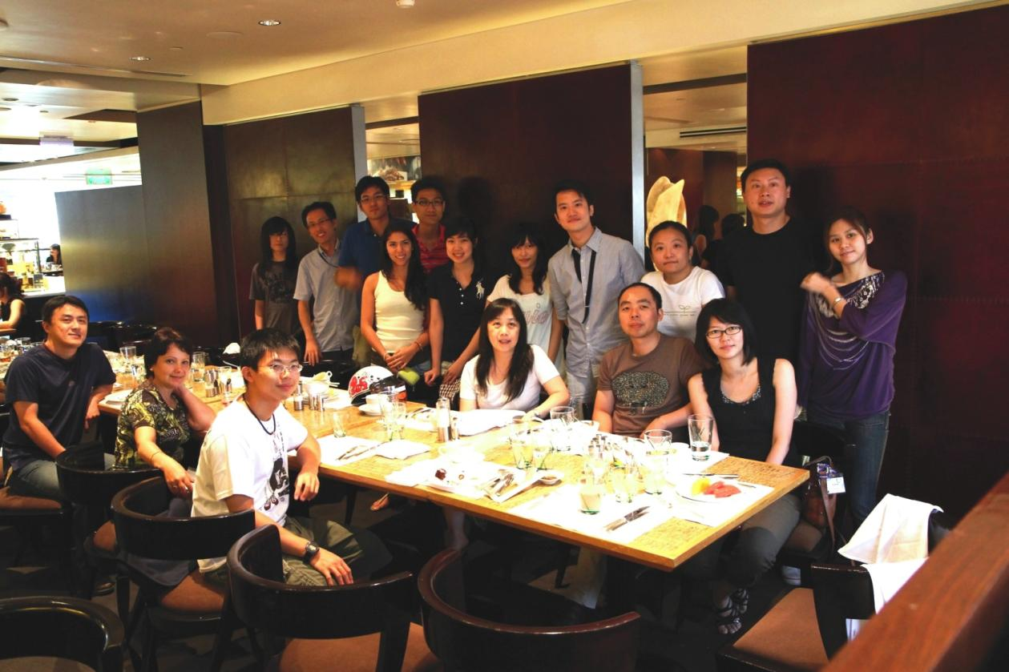
Group lunch in 2010
楊哲權畢業

Slide 13
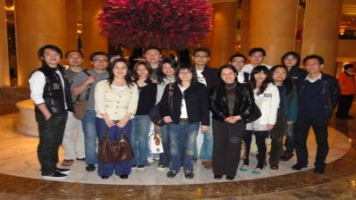
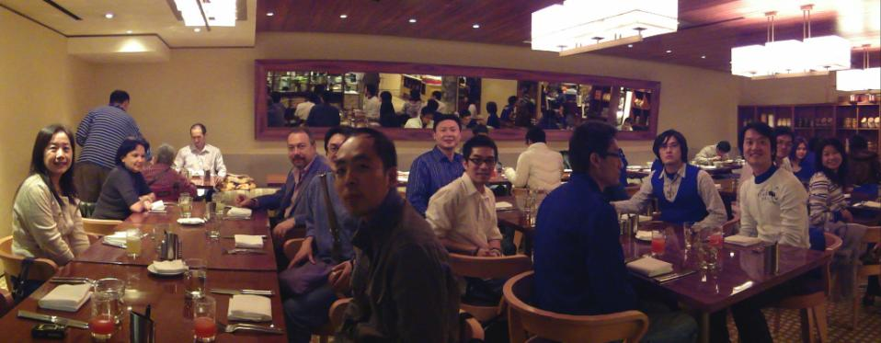
Group lunch in 2010

Slide 14
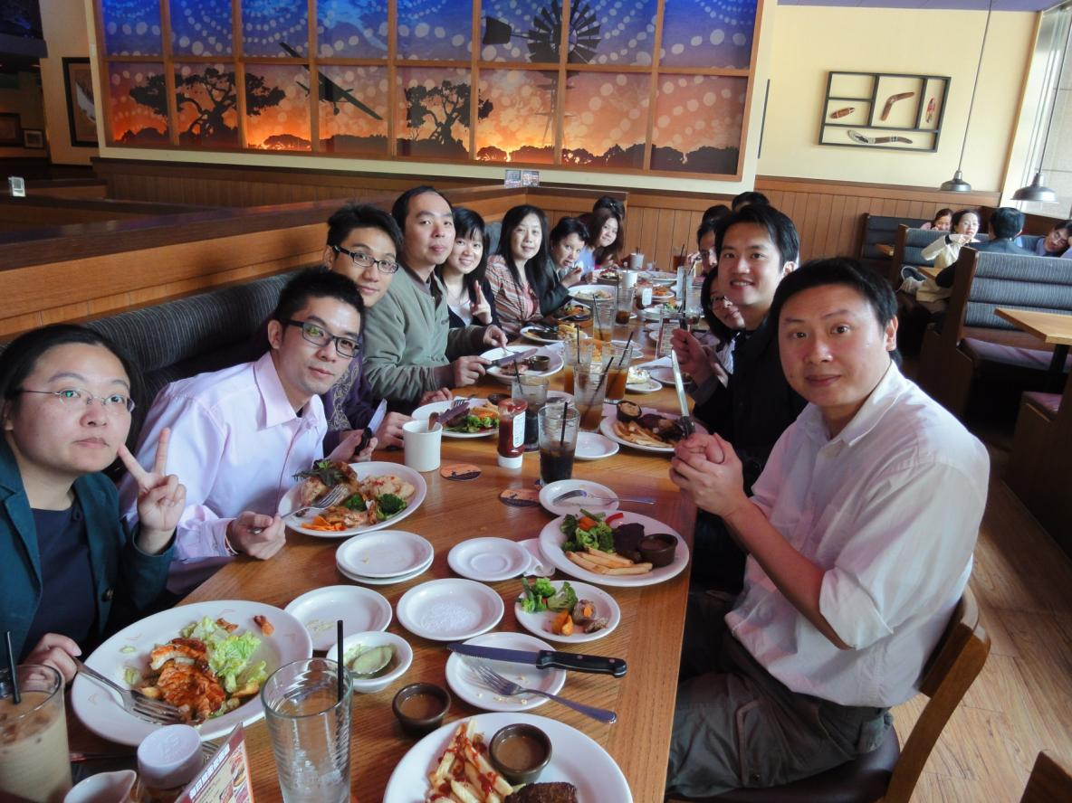
Group Lunch in 2010 Farewell
歡送 石仲浩

Slide 15
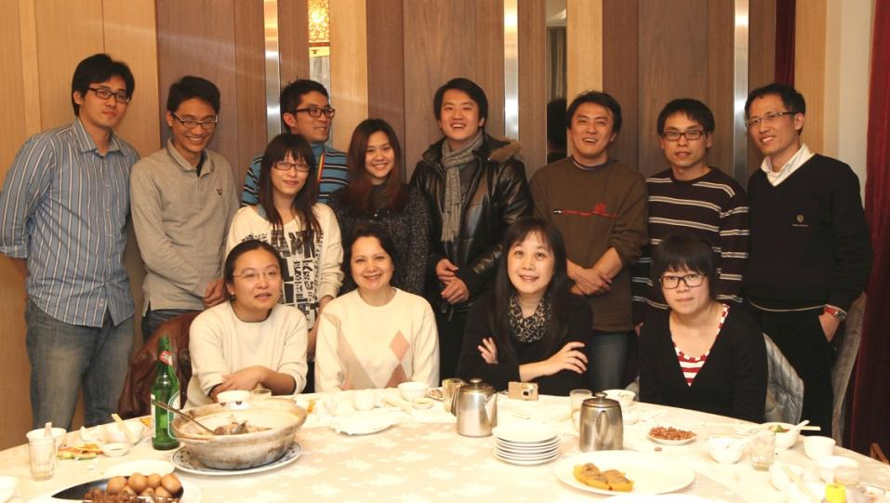
Group Lunch in 2011

Slide 16
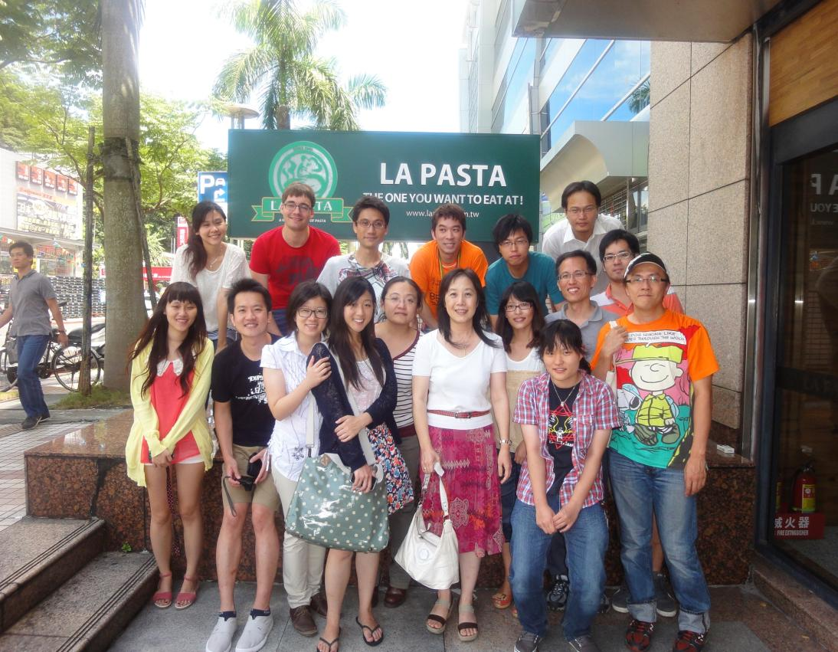
Group Lunch in 2012
林佳良、杜莉雲畢業

Slide 17
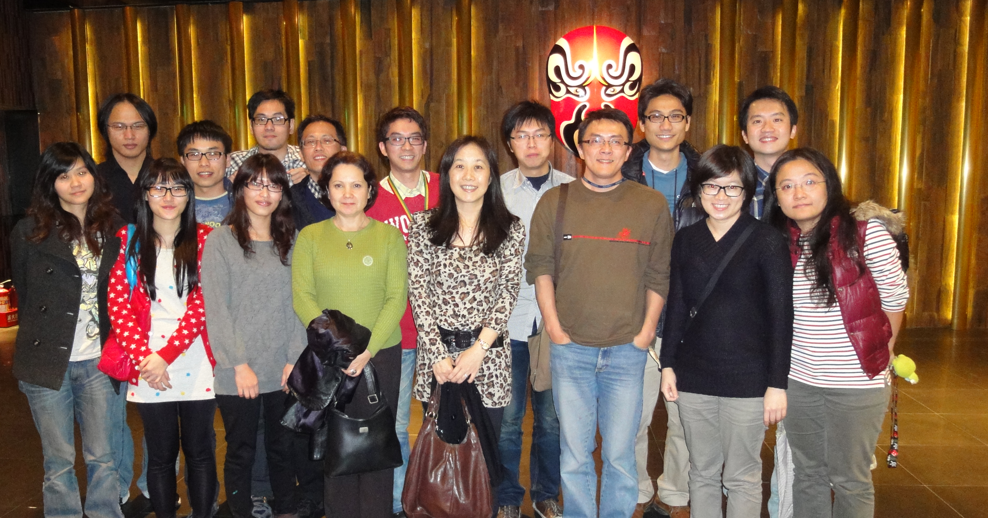
Group Lunch in 2012

Slide 18
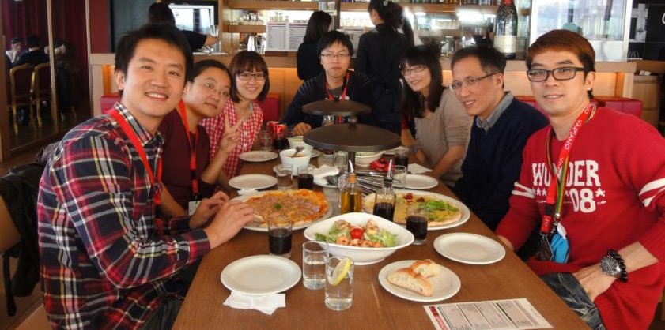
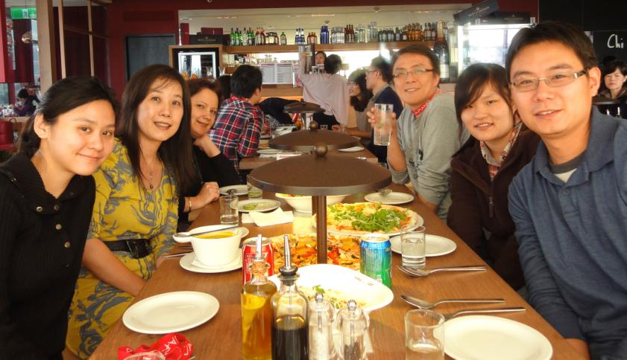
Farewell lunch for 王宜婷 in 2012

Slide 19
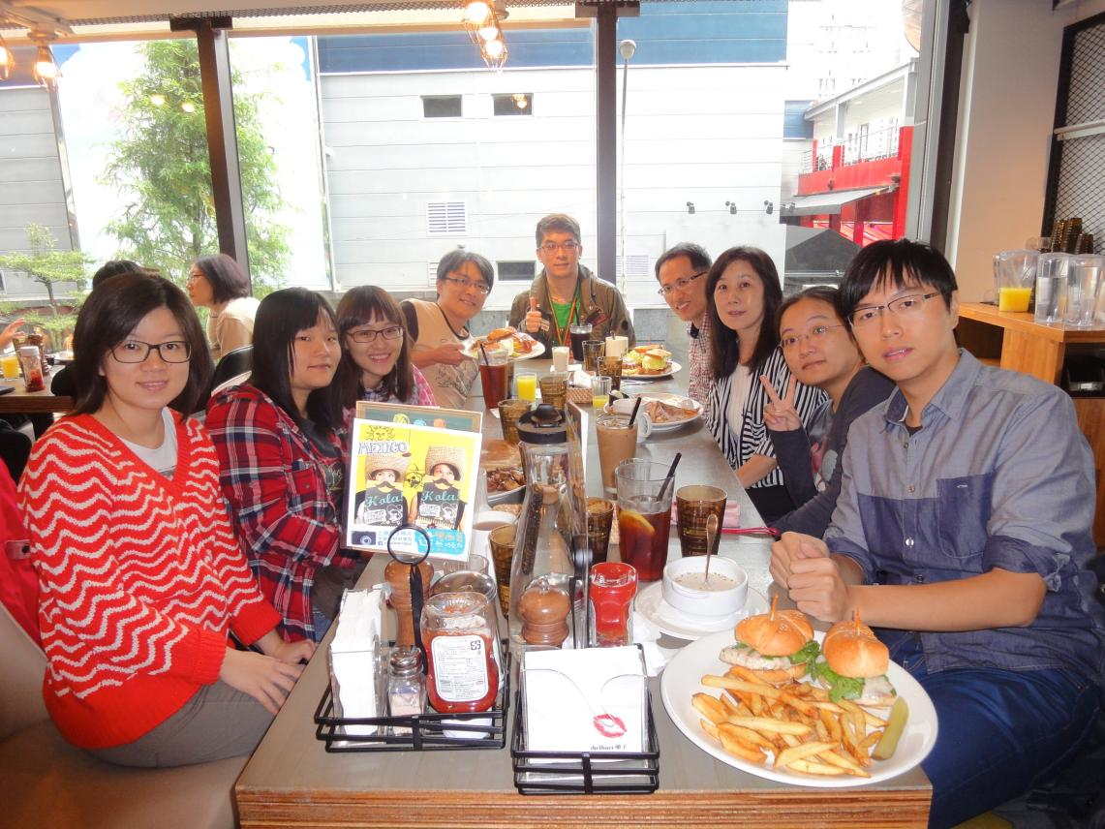
Group Lunch in 2013
易婉莉畢業

Slide 20
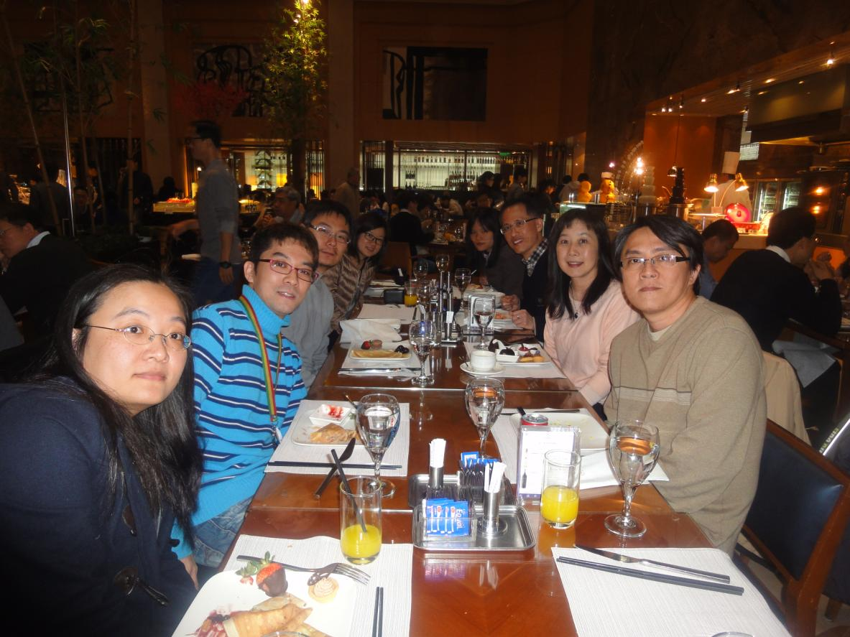
Group lunch in 2014

Slide 21
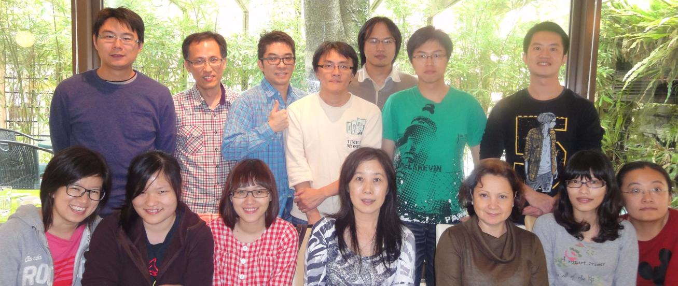
Farewell lunch for Lucy in 2013

Slide 22
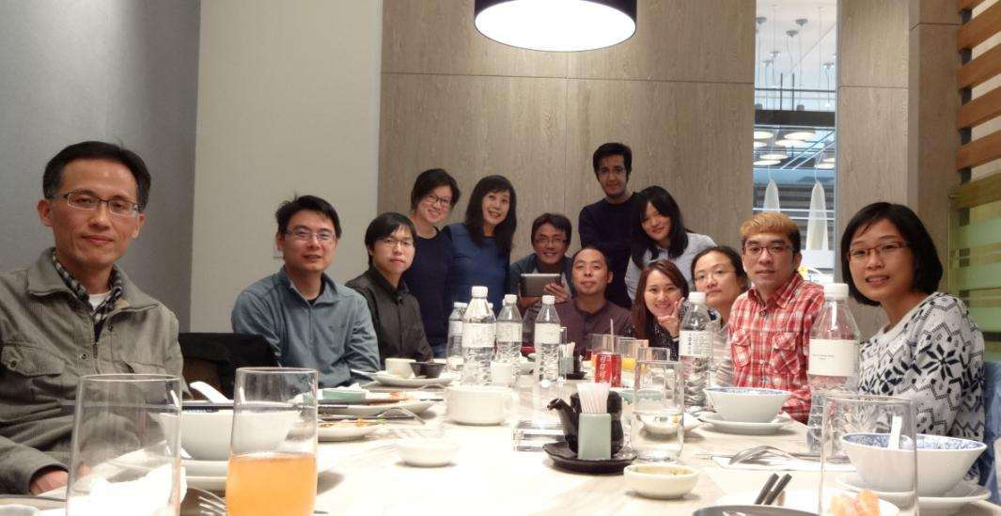
Group lunch in 2015

Slide 23
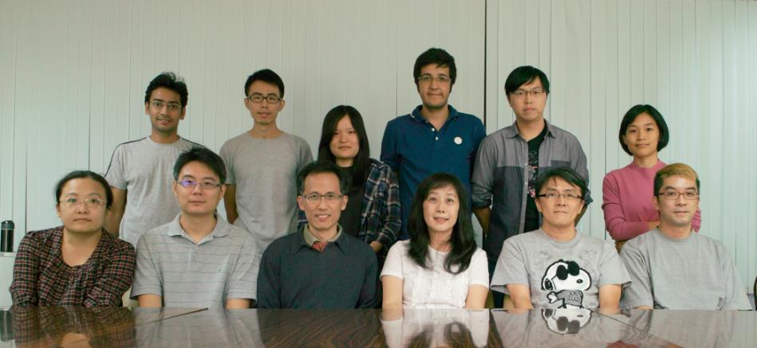
Group members in 2015
Hanna Yuan’s lab

Slide 24
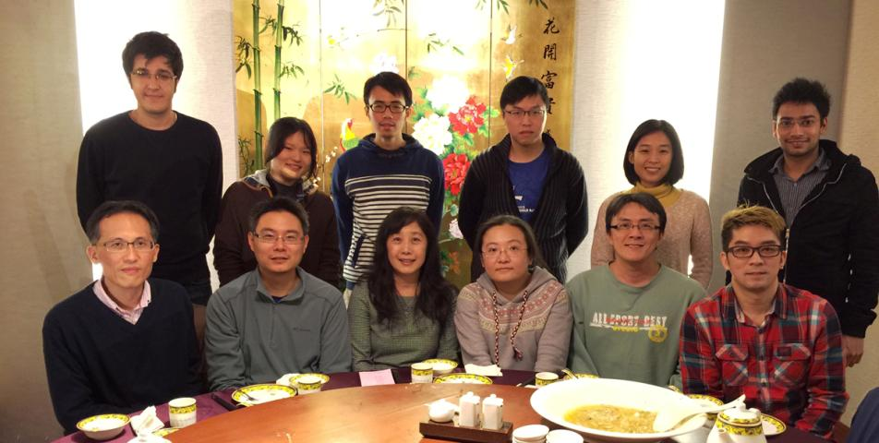
Group lunch in 2016

Slide 25
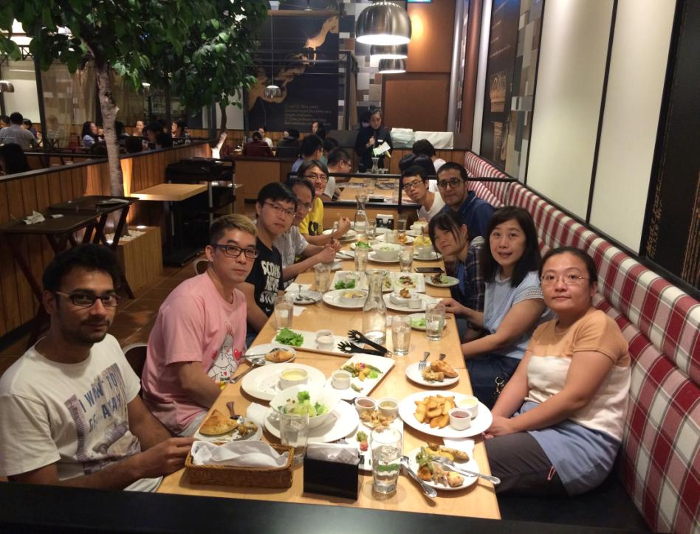
Group lunch in 2016
江建豪畢業

Slide 26
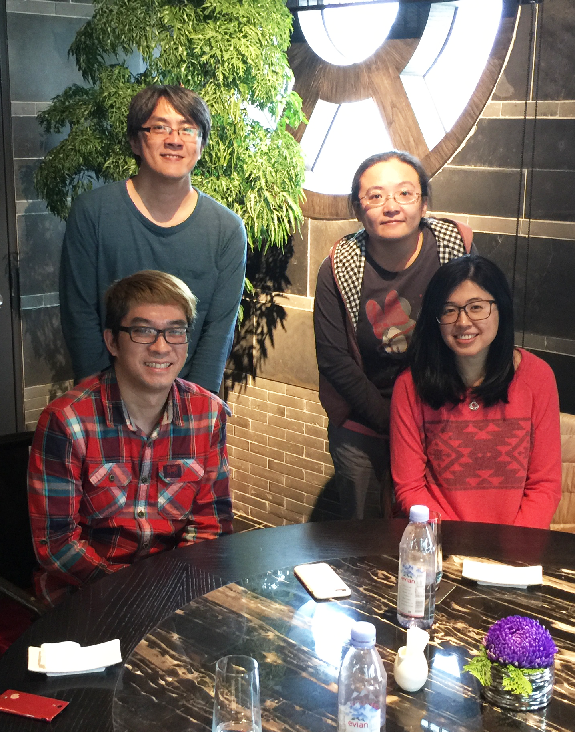
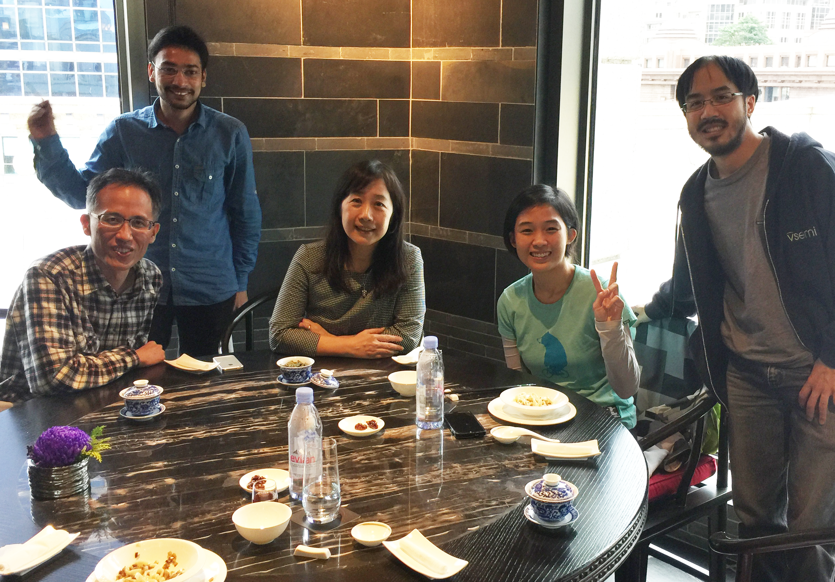
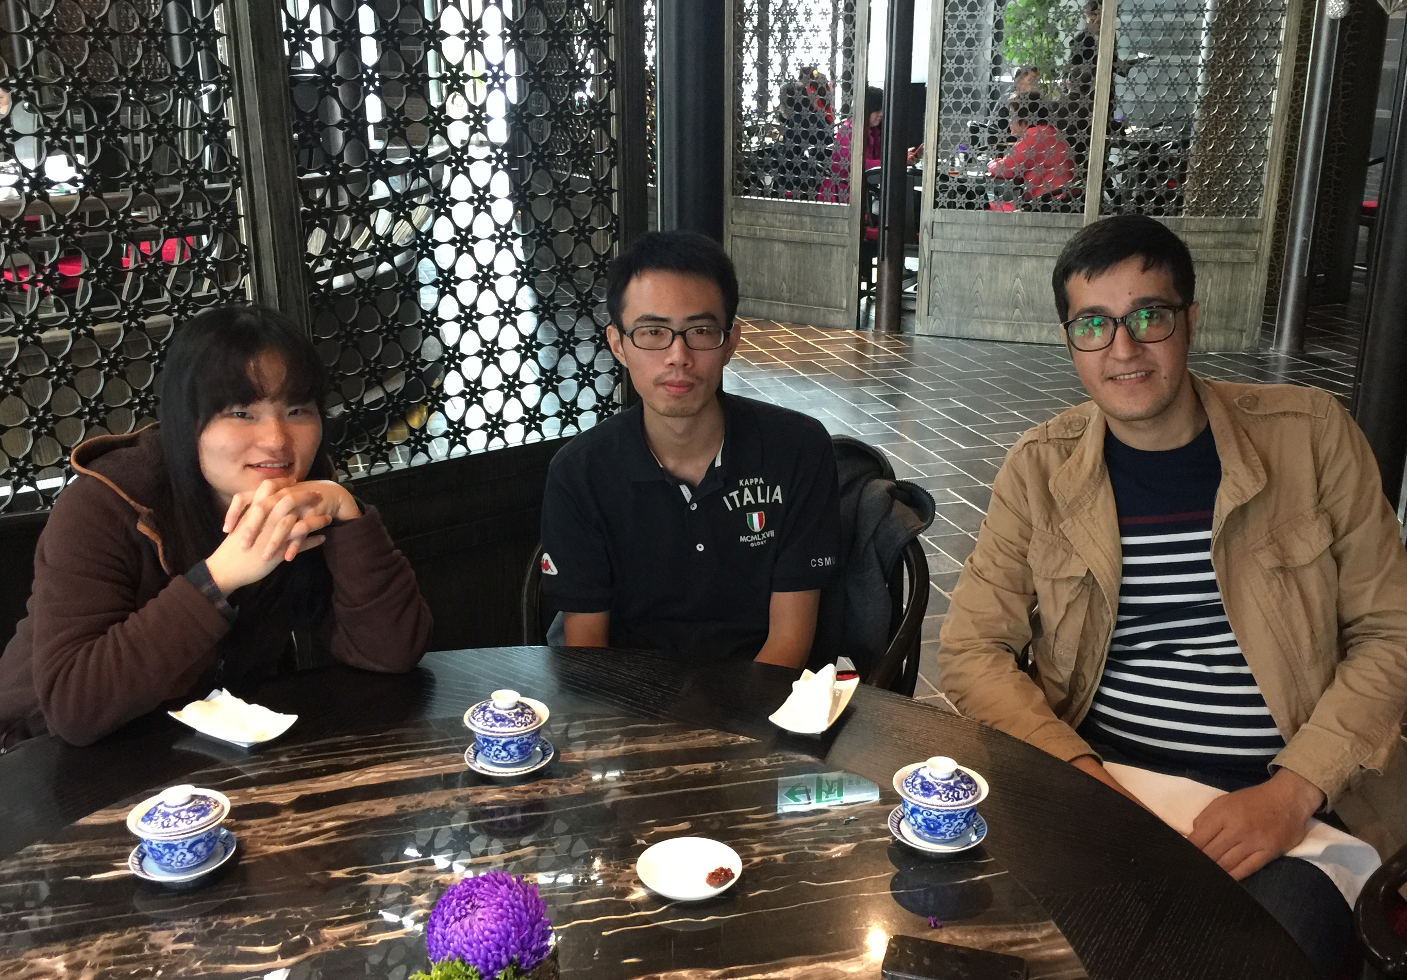
Group lunch in 2016 and
farewell for Jennifer Huen 禤佳瑋

Slide 27
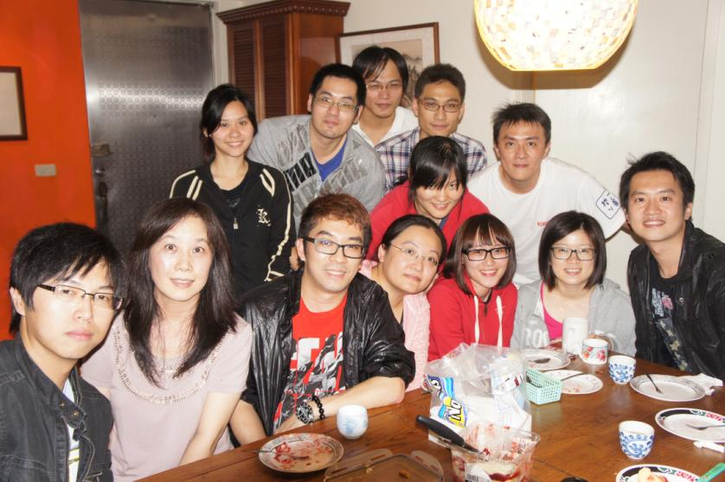
Group BBQ Dinner in Hanna’s home in 2012

Slide 28
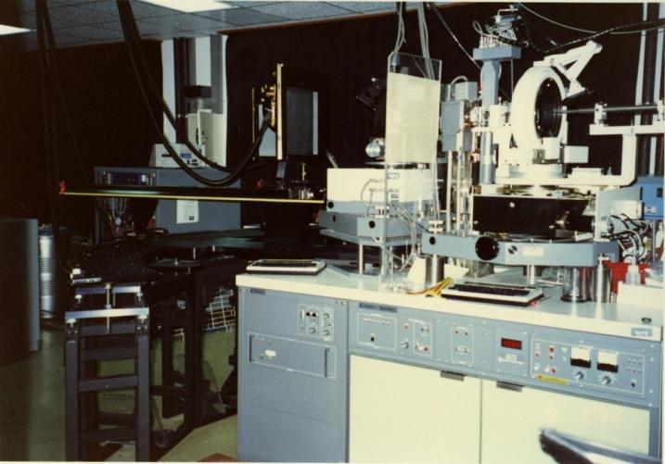
Hanna Yuan’s Lab lunched in 1992
X-ray diffraction facility in IMB in 1992

